Slide 1
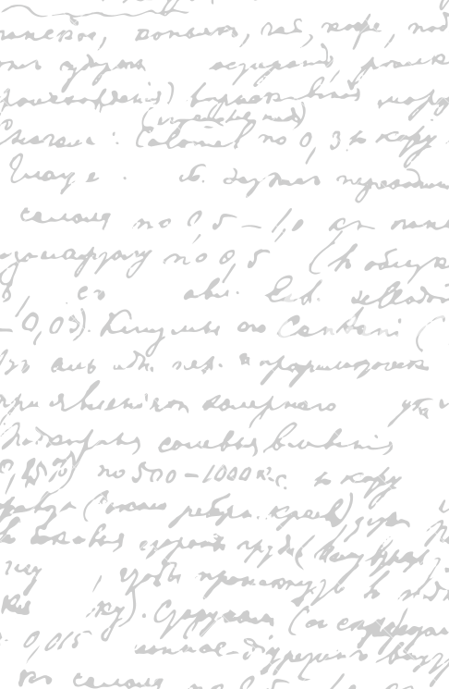

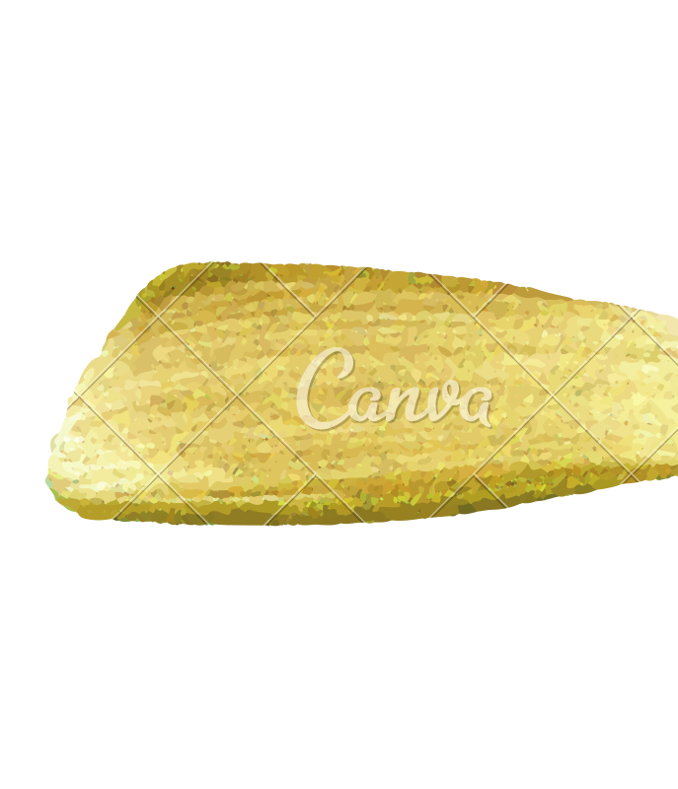

Ming Wu (Andrew) 2133861w
Laser Mate!
Project Supervisor Meeting 10
22 January 2021

Slide 2
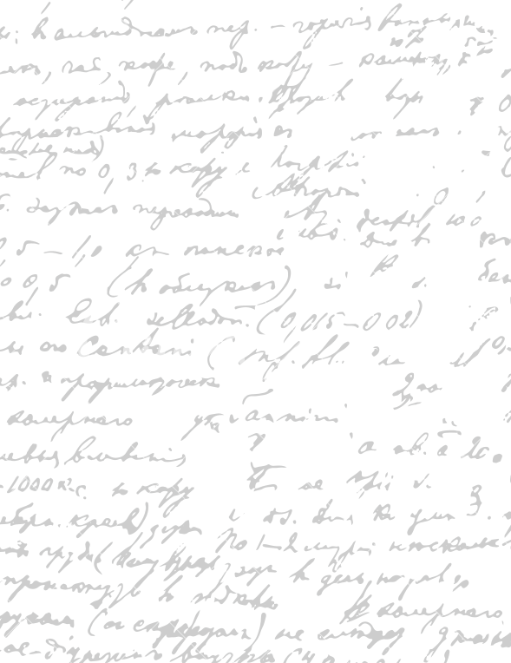

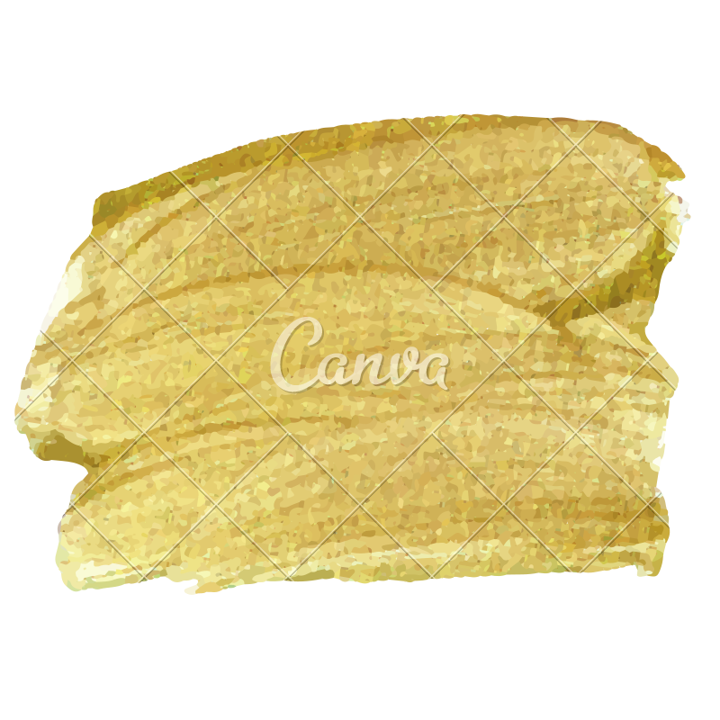

Start Recording

Slide 3
Main Topics
Current progress
2. Evaluate and refine digital prototype
3. Refine dissertation

Slide 4
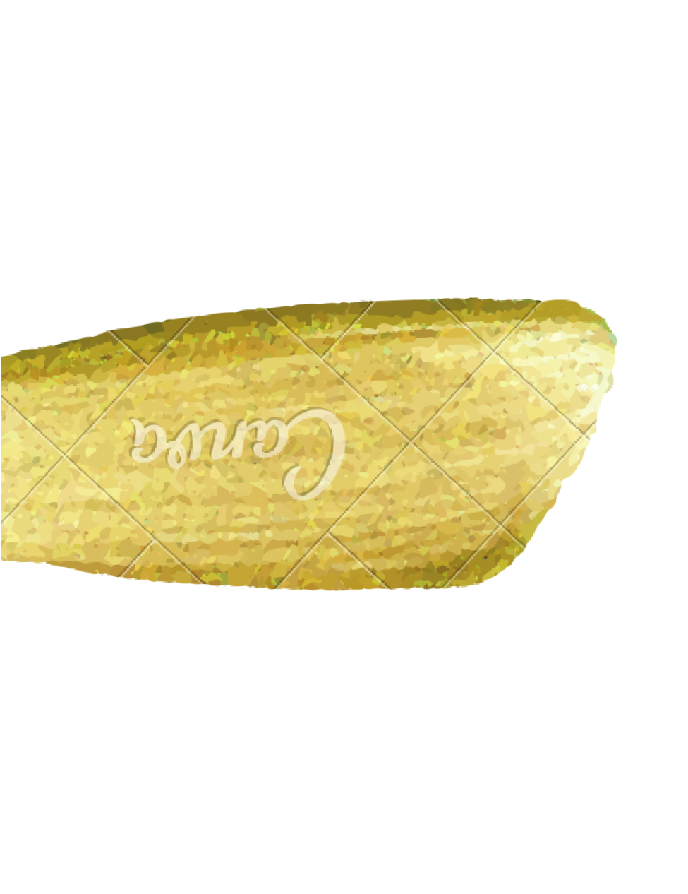
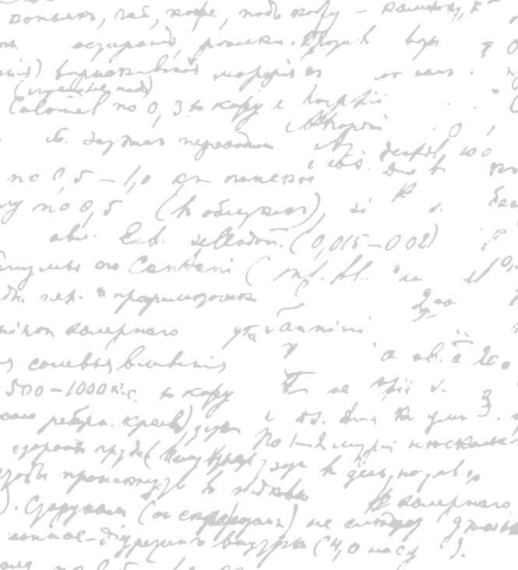

What I have done this week?
Move the functions around so that it is simpler to call repeating functions. Create a swiping effect for the meal page at the start
Question: whether the current design fits the feels of all restaurant types. Do you think our purpose yellow design would fit both a Japanese restaurant and a steak house?
Show current progress,
Identify weaknesses and possible solutions
Identify future work
Notes
- Future work: customerise colour
Current Progress

Slide 5
2. Evaluate and Refine Current Digital Prototype
Restaurant Owner
Company Staff
Company CEO
Password staff login see owner site
Remove qr code
Don’t store bank details – law
Don’t think about this, think about this after the project – not important
For each software part,
- describe why it is a good design; suggest areas of improvement, consider alternative designs.
Colour Scheme/ Contrast
Font Size/ Style
Way of presentation (order of information display)
Word Choice/ image
Icon shape/ size
Spacing/ Proximity between words/images
Software process (how to navigate between pages)
Necessity (whether this part must be present)
What can be added and why
What can be deleted and why
What can be improved and how/ identify the solutions

Slide 6
Go through only the most important part of each section of the dissertation
describe what you write and why you write it
Determine whether this section is important to put in
What is missing in this section
What points to delete in this section
Possible writing template/ example work for reference
3. Refine dissertation

Slide 7
End

